Slide 1
Curso Desarrollo Office 365
Marzo 2015

Slide 2


Getting started with the Office 365 APIs
Alberto Diaz Martin (@adiazcan)
Principal Team Leader en ENCAMINA
MVP de SharePoint Server

Slide 3
Agenda
Intro to the Office 365 APIs
Getting started
Demos
Notes:
What new APIs are available, in preview, in the Office 365 Platform
How to use these API’s in your platform of choice
Some sample business scenarios for leveraging these API’s
Level: Intermediate
Audience: Developer Essentials

Slide 4
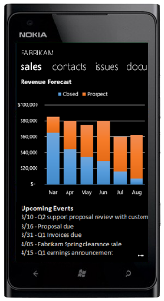
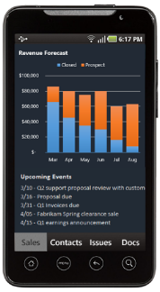








La plataforma de desarrollo de Office
Everywhere
HTML
Modern
Language agnostic
Web Application Host
Services
Azure AD applications
Office Graph
Files
Mail
Calendar
Contacts
Lync
Social

Slide 5
Intro to the Office 365 APIs

Slide 6
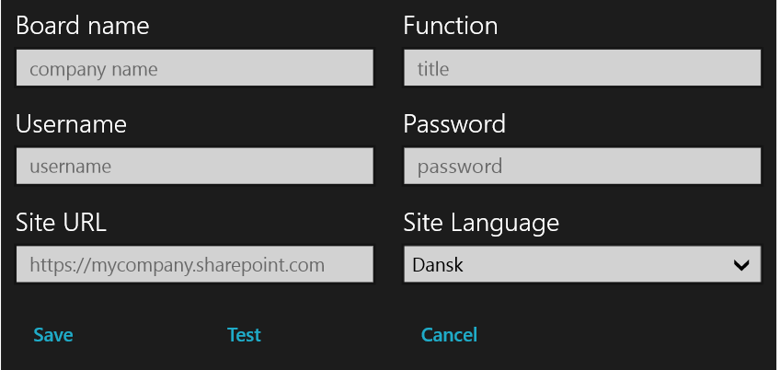
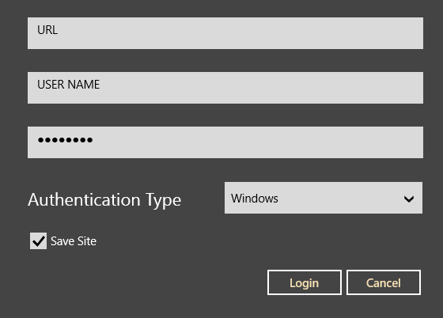
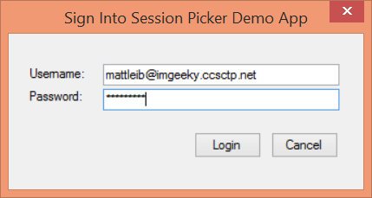
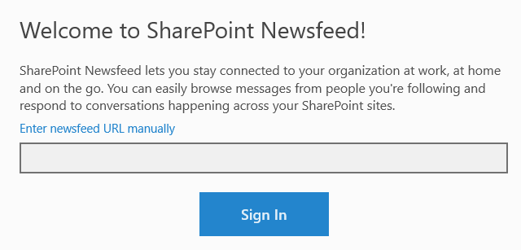
Office 365 device Apps

Slide 7
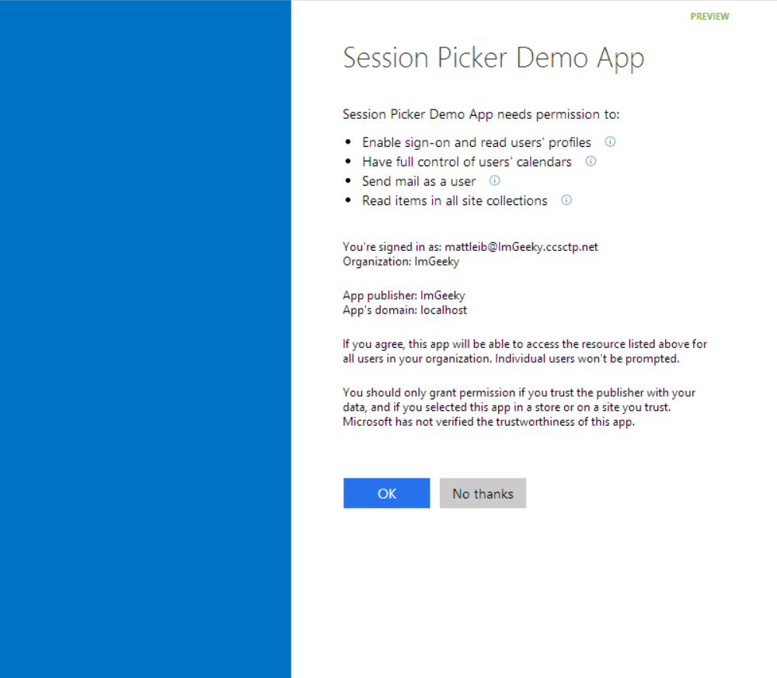
Consentimiento común

Slide 8
Autenticación simple para Office 365
Azure AD graph, Exchange, SharePoint,…
Device apps y sitios web
Consentimiento del Admin y usuario final

Slide 9
Protocolo Seguro
OAuth 2.0
No captura as credenciales del usuario
Ámbito limitado de acceso
Soporta MFA y autenticación federada
Acceso Long-term con tokens de refresco

Slide 10
Servicio de descubrimiento de Office 365
Determina automáticamente la URL de los servicios de Office 365
Soporte Device App y sitios web
Usa la autenticación de Azure AD
Información se almacena en los servicios de AAD

Slide 11
Las APIs de cliente de SharePoint
Sites, Lists and Libs
Workflow
Search
Taxonomy
BCS
…
_api
Execute query
REST/ OData
JavaScript library
Silverlight library
.Net CLR library
Custom client code

Slide 12
Office 365 APIs Roadmap
Active Directory
Exchange & Outlook.com
SharePoint
OneDrive
Sites
OneDrive
Users
Mail
Calendar
Client API
OneDrive for Business
Sites, Lists and Libs
Taxonomy
Groups
Contacts
Workflow
BCS
Search
…

Slide 13
Getting Started

Slide 14
http://aka.ms/o365apis

Slide 15
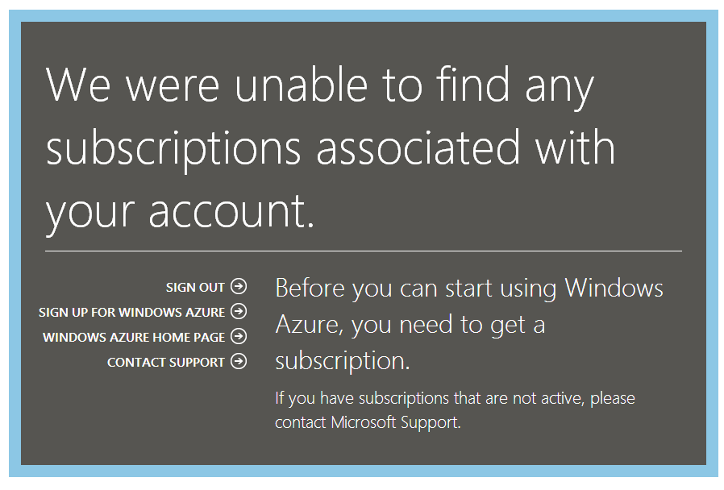

Slide 16
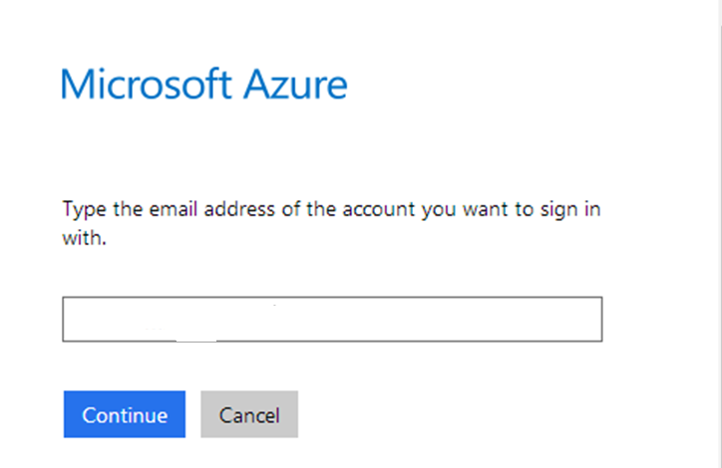

Slide 17
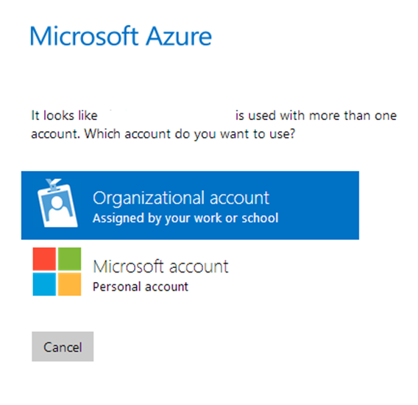

Slide 18
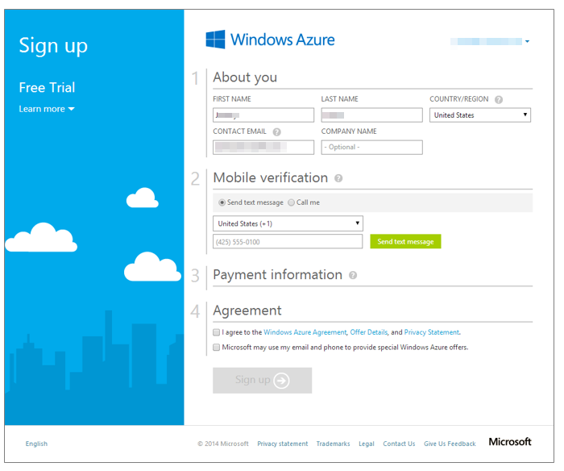

Slide 19
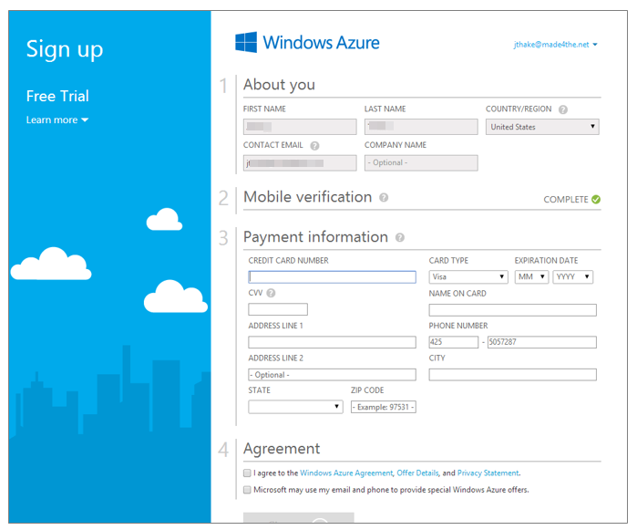

Slide 20
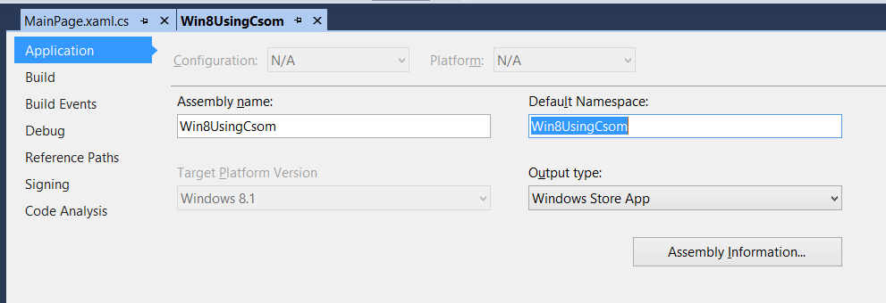

Slide 21
demo
Azure Active Directory portal

Slide 22
demo
Authentication process
Notes:
Use demo sample from MSDN Code Gallery http://code.msdn.microsoft.com/Office-365-APIs-How-to-use-609102ea

Slide 23
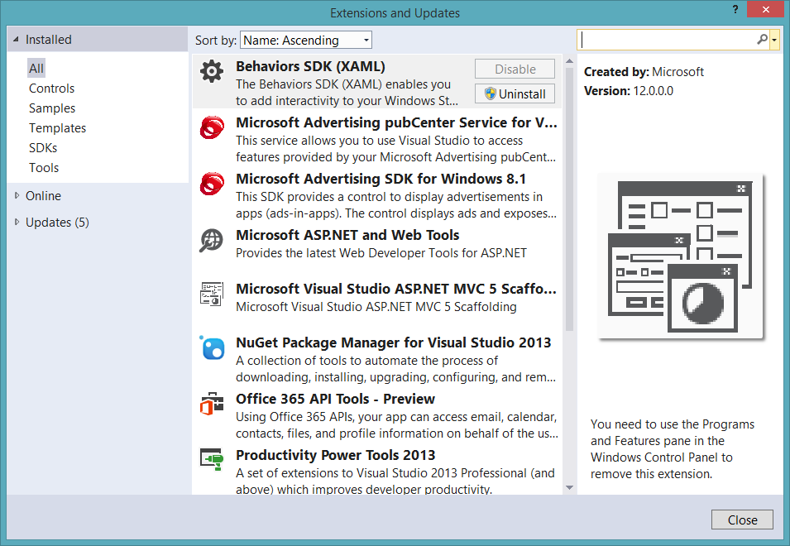
Get the tools

Slide 24
Soporte de proyectos de Visual Studio
.NET Windows Store Apps
Windows Forms Application
WPF Application
ASP.NET MVC Web Application
ASP.NET Web Forms Application
Xamarin Android and iOS Applications
Multi-device Hybrid Apps (Cordova)

Slide 25
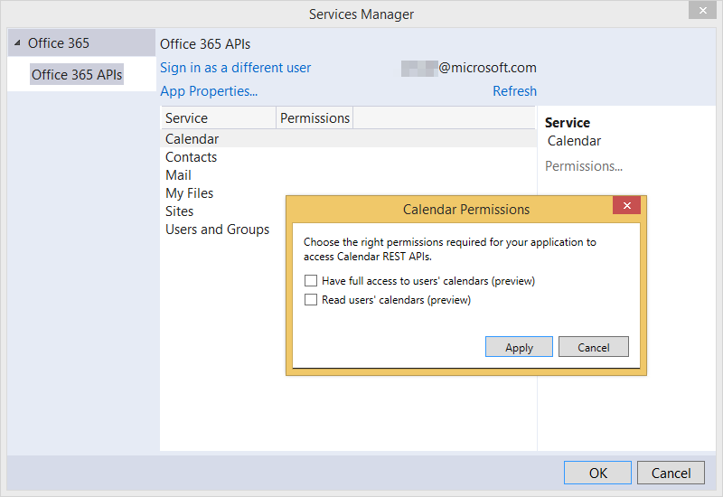

Slide 26
demo
Getting started Office 365 API tools for VS ASP.NET MVC

Slide 27
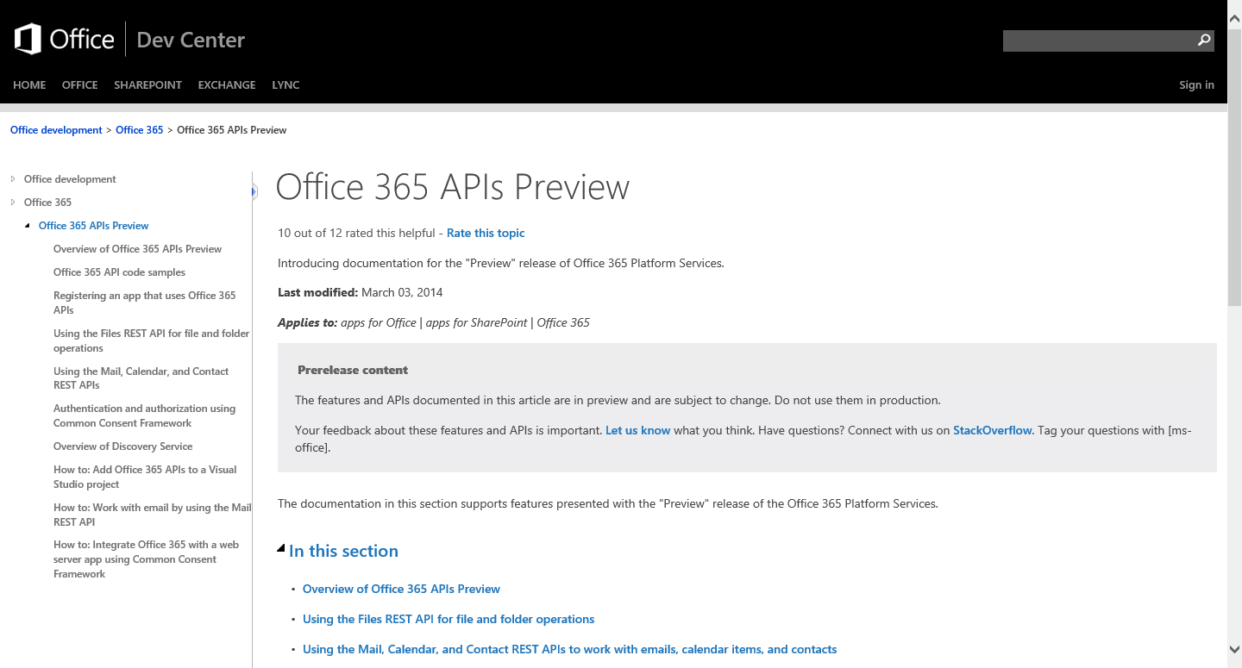
http://aka.ms/Office365DevAPIs

Slide 28
Demos

Slide 29
demo
ASP.NET MVC project demo
Notes:
SharePoint Power Hour O365aPI Full Stack demo https://github.com/OfficeDev/SharePoint-Power-Hour-Code-Samples/tree/master/O365ApiFullStack

Slide 30
demo
AngularJS HTML/JS project demo
Notes:
Research Project

Slide 31
Conclusiones
Nueva forma para llamar a servicios de Office 365
Disponible en preview

Slide 32
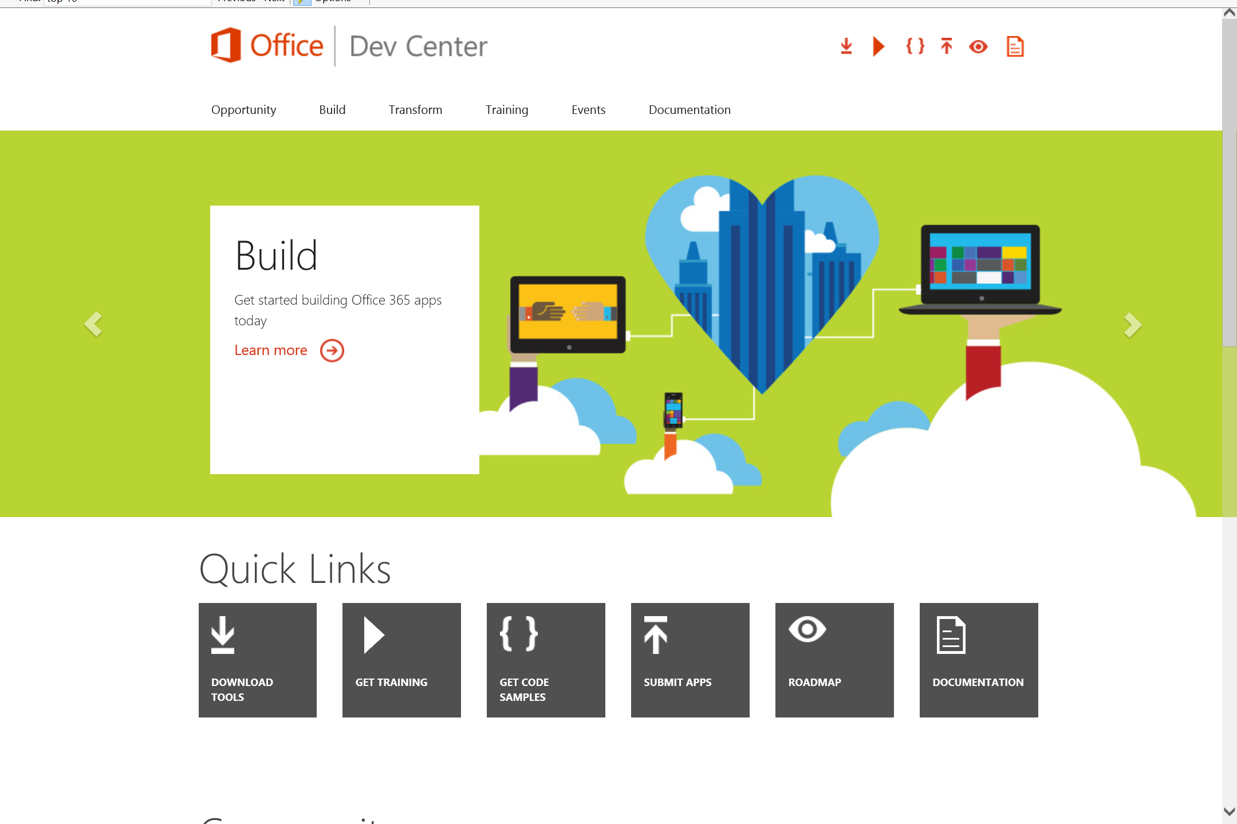
Dev.
Office
.com
One stop shop for Office Developer Platform

Slide 33



Calls to action
Explore our developer center
http://dev.office.com
Jumpstart into our training http://dev.office.com/training
Play with our code samples http://dev.office.com/code-samples
Get answers
http://aka.ms/AskSharePoint
http://aka.ms/AskOffice
Give feedback Drive our roadmap http://aka.ms/OfficeDevFeedback

Slide 34


Transform your code Providing App Model Patterns for common Full Trust Code scenarios
60+ Visual Studio projects Common scenarios
Branding
Site provisioning
Remote event receivers
Large file support
Taxonomy driven navigation
And much more…
Contribute
Open source coming soon!
Developer
Patterns & Practices
aka.ms/OfficeDevPnP

Slide 35
Microsoft Virtual Academy courses
2014
2015
Deep Dive into integrating Office 365 APIs with your mobile device development
Deep dive into the building blocks and services of the SharePoint platform
Deep Dive into integrating Office 365 APIs with your standalone web application development
Introduction to Office 365 Development
Deep Dive into the Office 365 App Model
Deep Dive into Office 365 Development on non-Microsoft Stack
Shipping your Office 365 App to the Office Store
Aug
Sept
Oct
Nov
Dec
Jan
Feb

Slide 36

© 2014 Microsoft Corporation. All rights reserved. Microsoft, Windows, and other product names are or may be registered trademarks and/or trademarks in the U.S. and/or other countries.
The information herein is for informational purposes only and represents the current view of Microsoft Corporation as of the date of this presentation. Because Microsoft must respond to changing market conditions, it should not be interpreted to be a commitment on the part of Microsoft, and Microsoft cannot guarantee the accuracy of any information provided after the date of this presentation. MICROSOFT MAKES NO WARRANTIES, EXPRESS, IMPLIED OR STATUTORY, AS TO THE INFORMATION IN THIS PRESENTATION.

